Slide 1
Lake Shore High School
Freshman Course Registration

Slide 2
Welcome to Lake Shore High School!

Slide 3
Your Counselor (By last name)
Mrs. Lukacsy (A-G)
Mrs. Weiss (H-O)
Dr. Lip (P-Z)

Slide 4
During the scheduling process, the Goal of the Counseling Department is to assist you in…
Selecting courses to ensure you will meet state and district graduation requirements
Choosing courses that align with your career pathway to ensure that your education is relevant to post-high school aspirations, and
Choosing courses that will challenge you and pique your interest
Appropriate course level placement is CRITICAL to your academic success!

Slide 5
Trimester Guide
Each square is one course
Each course is 0.5 credits
Each term a student can earn 2.5 credits
Each school year a student can earn 7.5 credits
Students have the opportunity to earn 30 credits over four years
 | Fall | Winter | Spring
1st hour
2nd hour
3rd hour
4th hour
5th hour

Slide 6
Where are you planning on going to college?
To earn a diploma, you’ll need 4 years of English, Math, 3 years of Science, and 2 years of a Foreign Language.
Colleges like to see applicants that take ADDITIONAL core credits, above and beyond what the state requires.
*Keep this in mind when scheduling courses!*

Slide 7
Graduation requirements can be found on the left hand side of registration form
Course options can be found on the backside of your registration form.

Slide 8
Course Book
Log onto: http://lakeshoreschools.org/
Click on “Lake Shore High School”
Click on “Course Selection”
Click on “Course Offerings Guide”

Slide 9
Elective Options
Intro to Drafting/CAD 1 Term in Duration GEC
Intro to Building Renovation 1 Term in Duration GEC
Girls Intro to Renovation 1 Term in Duration GEC
Intro to Visual Art 1 Term in Duration VPAC
Drawing/Design 1 Term in Duration VPAC Pre-Requisite: Intro to Visual Art
Painting 1 Term in Duration VPAC Pre-Requisite: Intro to Visual Art
Intro to Music 1 Term in Duration VPAC
Guitar 1 Term in Duration VPAC
Symphonic Band 3 Terms in Duration VPAC
Treble Choir (Freshman Girls) 3 Terms in Duration VPAC
Concert Choir (Freshman Boys) 3 Terms in Duration VPAC
Fitness & Conditioning 1 Term in Duration PEC
Swimming 1 Term in Duration PEC
Human Health 1 Term in Duration HC
German I A&B 2 Terms in Duration WLC
Mandarin I A&B 2 Terms in Duration WLC
Mandarin II A&B 2 Terms in Duration WLC BY KMS PLACEMENT
Spanish I A&B WLC 2 Terms in Duration
Spanish II A&B WLC 2 Terms in Duration BY KMS PLACEMENT
Intro to Web Design 1 Term in Duration VPAC/TC
Adv. Web Design 1 Term in Duration Pre-Requisite: Web Design VPAC/TC

Slide 10
Courses you will take as a 9th grade student
9th Grade
1 – Literature and Rhetoric A
2 – Literature and Rhetoric B
3 – Literature and Rhetoric C
4 – World History I
5 – World History II
6 – Biology I A
7 – Biology I B
8 – Earth Science
9 – Math: Algebra 1 A
10 – Math: Algebra 1 B
12 – Math: Algebra 1 C
12 – Career/Tech Foundation
13 – Physical Education
14 – Elective
15 - Elective

Slide 11
What will a common 9th grade schedule look like ?
Fall | Winter | Spring
Literature and Rhetoric A | Career &Tech Foundation | Literature and Rhetoric C
Algebra I A | Algebra I B | Physical Education
World History I | Literature and Rhetoric B | World History II
Biology I A | Biology I B | Earth Science
Elective | Elective | Algebra I C

Slide 12
Scheduling Time Line
Registration sheets must be completed, signed by you and your parent and brought back to school on February 21st and 22nd.
On February 21st and February 22nd, the counselors will begin meeting with you to finalize your course selections for next school year.

Slide 13
Scheduling Time Line
March-May
Electronic course requests will be tabulated to determine course offerings and staffing for the upcoming school year.
August
Students will attend a registration day. During this time, students may purchase their yearbooks, have their school pictures taken, and are provided with their locker combination and location for the school year. At this time, students may also be given an updated schedule if staffing or course changes were made during the summer vacation.
Schedule Changes
Each year, a new master schedule is created to accommodate students’ course requests made during registration in February and March. Faculty members are employed, textbooks are purchased, and rooms are assigned on the basis of these requests.
Once the semester has begun, schedule change requests must be made by completing a schedule request change form. These requests will be honored for exceptional circumstances, as space is available.

Slide 14
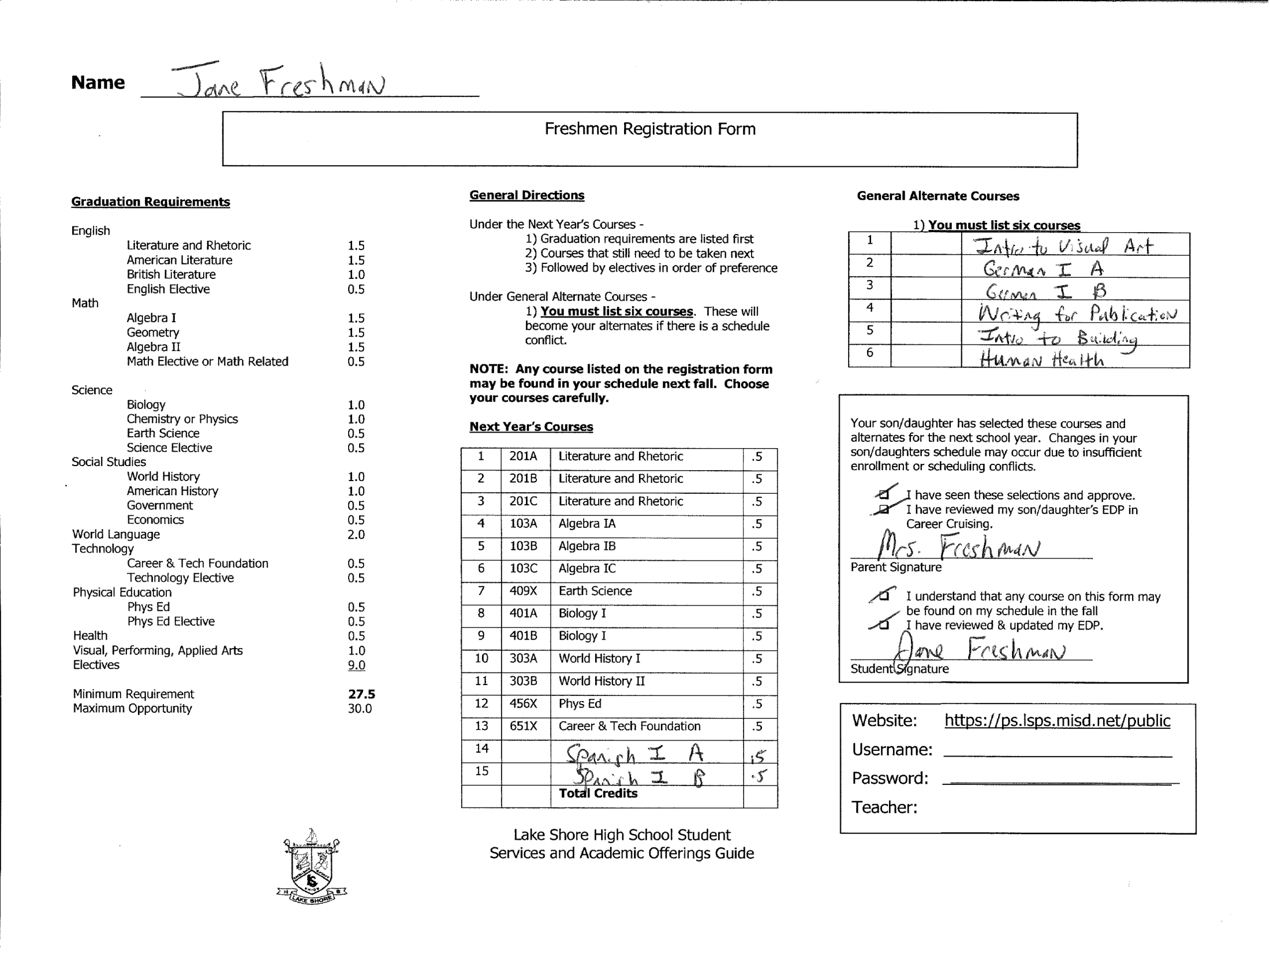

Slide 15
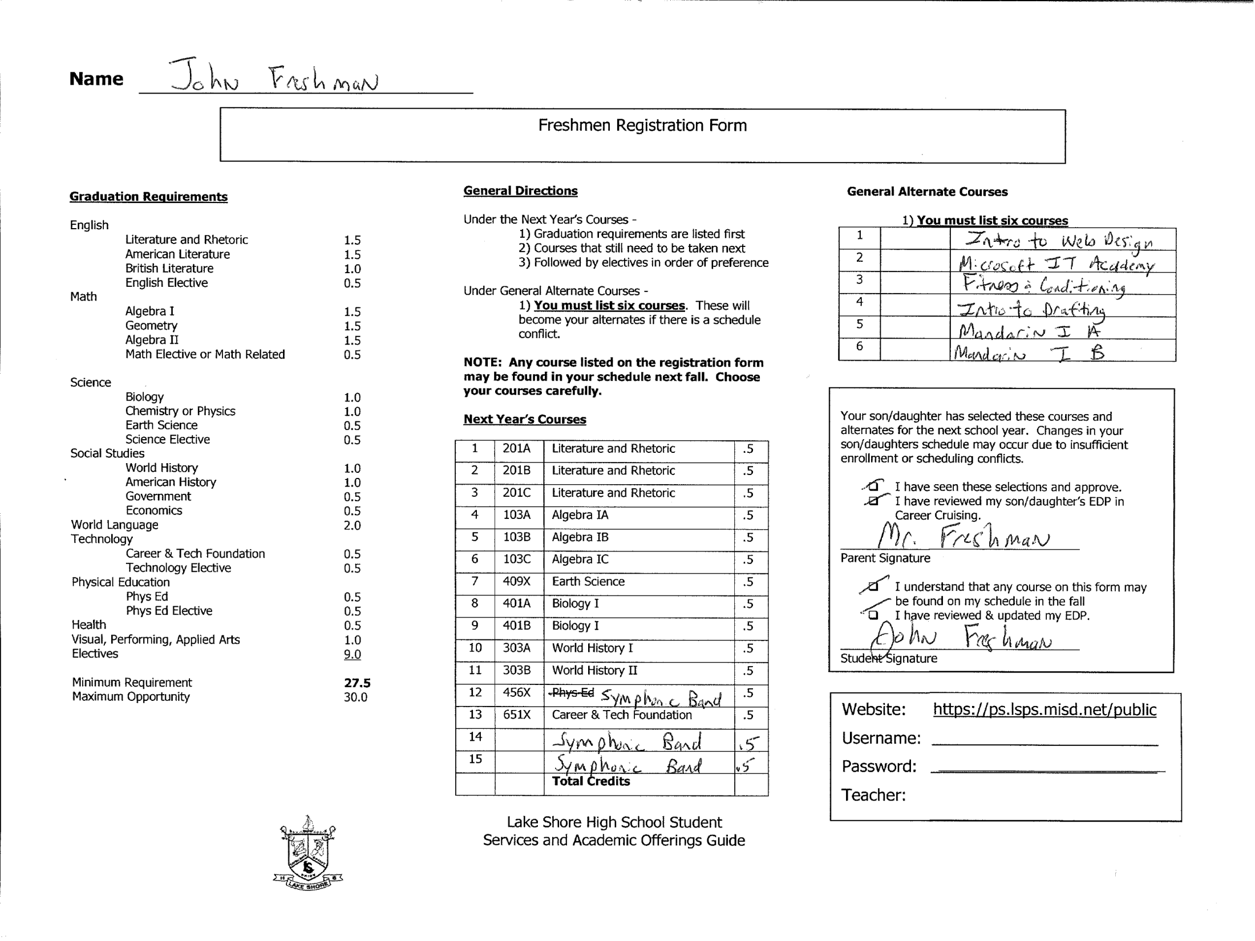

Slide 16
Getting Started
Log into Powerschool https://ps.lsps.misd.net/public/home.html
Your Username and Password is on the top of your scheduling form.
REMEMBER – Your password IS case sensitive!

Slide 17
Select ‘Class Registration’ from the left side of the screen

Slide 18
You will see that all of your core requirements have been selected for you

Slide 19
Move to the line titled ‘9th Grade english’. Select the box with the pencil at the end of the row to choose your english classes.

Slide 20
You must choose literature & rhetoric A, B, & C -or- if you are currently in honors english, you must select honors literature & rhetoric a, B, & c. When you have selected your courses, press ‘Okay’.

Slide 21
Move to the line titled ‘9th Grade Math’. Select the box with the pencil at the end of the row to choose your Math classes.

Slide 22
You must choose Algebra 1A, Algebra 1B, & Algebra 1C -or- if you are in advanced algebra now, you must select geometry a, geometry b, and geometry c. When you have selected your courses, press ‘Okay’.

Slide 23
After pressing ‘okay’ your Math classes should be visible on the main request screen and the red exclamation point (!) should turn into a green check(P)

Slide 24
Move to the line titled ‘Ninth Grade Electives’. Select the box with the pencil at the end of the row to choose your Elective classes.

Slide 25
Select two elective courses and then press ‘Okay’

Slide 26
After pressing ‘okay’ your Elective classes should be visible on the main request screen and the red exclamation point (!) should turn into a green check (P)

Slide 27
Move to the line titled ‘Alternates’. Select the box with the pencil at the end of the row to choose your Alternate classes.

Slide 28
Choose up to 6 Alternates in case there are conflicts with your originally scheduled classes

Slide 29
After pressing ‘okay’ your Alternate classes should be visible on the main request screen and the red exclamation point (!) should turn into a green check (P)

Slide 30
Please review your choices, and once everything is correct press submit to enter your schedule requests

Slide 31
REMEMBER !!!
Take your scheduling document home and discuss your course selections with your parent/guardian
Use your identified career pathway as a guide for selecting your high school courses

Slide 32
VERY IMPORTANT!!
Your Course Request Forms are due
Thursday, February 21st
If you do not bring your Course Registration Form in signed by a parent, you will not be given priority consideration for your course requests.

Slide 33
Your Course Registration Form requires a Parent/Guardian Signature

